Slide 1

A New Variable Structure PID-Controller Design for Robot Manipulators
Presentation on
For the project of ENPM667
Aaqib Barodawala – 119348710
Shreejay Badshah – 119224564

Slide 2
Project Purpose
The purpose of this project is to design new Variable Structure PID-Controller for tracking stabilization of the robot.

Slide 3
How did we do it?
Considering the dynamics of the robot manipulator.
The new controller is designed using PID sliding controller with PID sliding surface.
Sliding condition are defined for the controller
Global Asymptotic Stability is examined.
Simulation with a reduced design is performed.

Slide 4
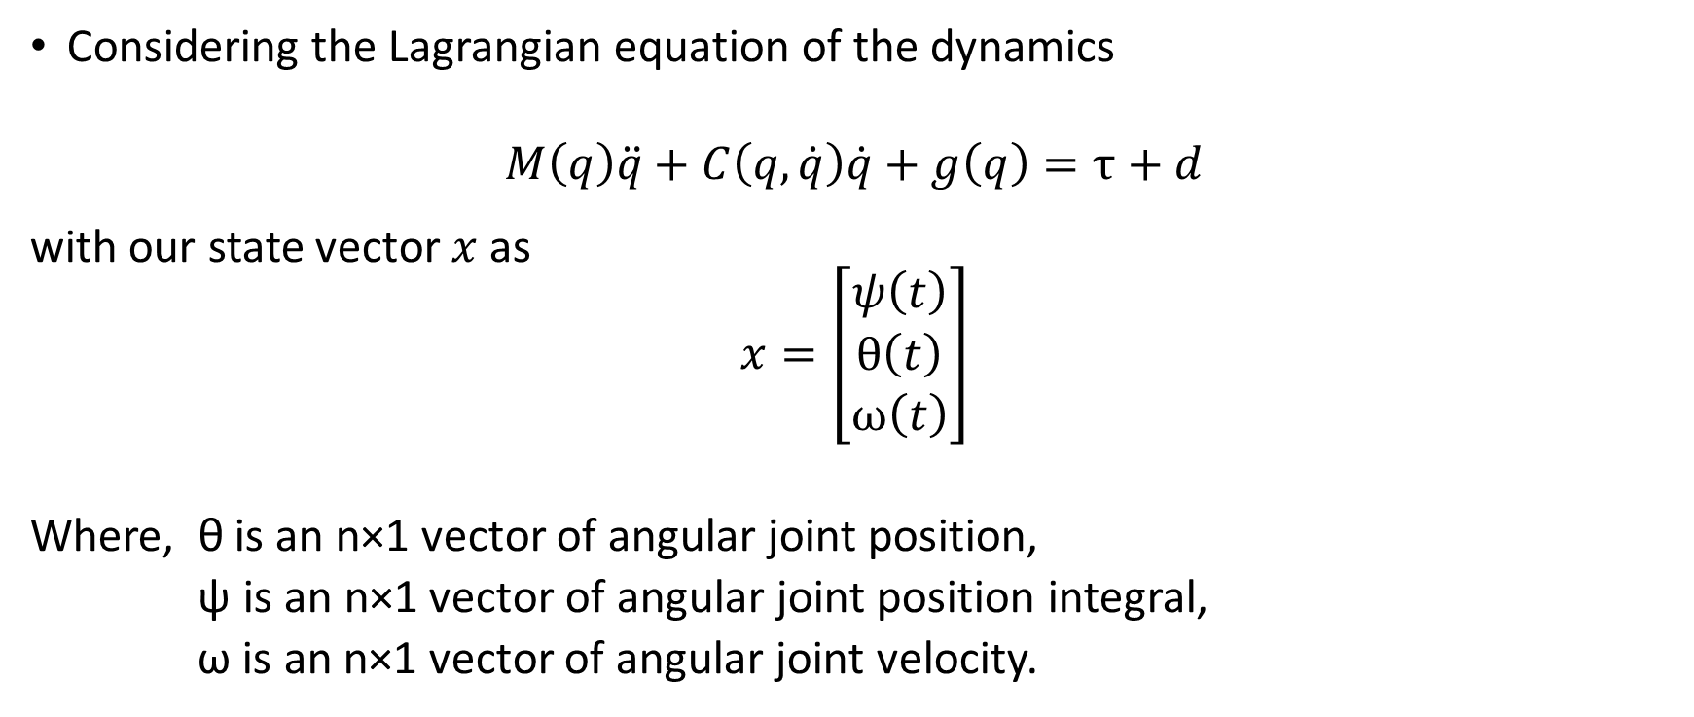
DYNAMICS OF THE ROBOTIC MANIPULATOR
Considering the Lagrangian equation of the dynamics
$$M\left(q\right)\ddot{q}+C\left(q,\dot{q}\right)\dot{q}+g\left(q\right)=τ+d$$
with our state vector $x$ as
$$x=\left[\begin{matrix}ψ\left(t\right) \\ θ\left(t\right) \\ ω\left(t\right)\end{matrix}\right]$$
Where, θ is an n×1 vector of angular joint position,
ψ is an n×1 vector of angular joint position integral,
ω is an n×1 vector of angular joint velocity.

Slide 5

We consider the following relations:
$\dot{ψ}=θ, \dot{θ}=ω$ and
$\dot{ω}=M{\left(θ\right)}^{−1}\left[−B\left(θ,\dot{θ}\right)\dot{θ}−f\left(\dot{θ}\right)−g\left(θ\right)+u\left(t\right)\right]$

Slide 6
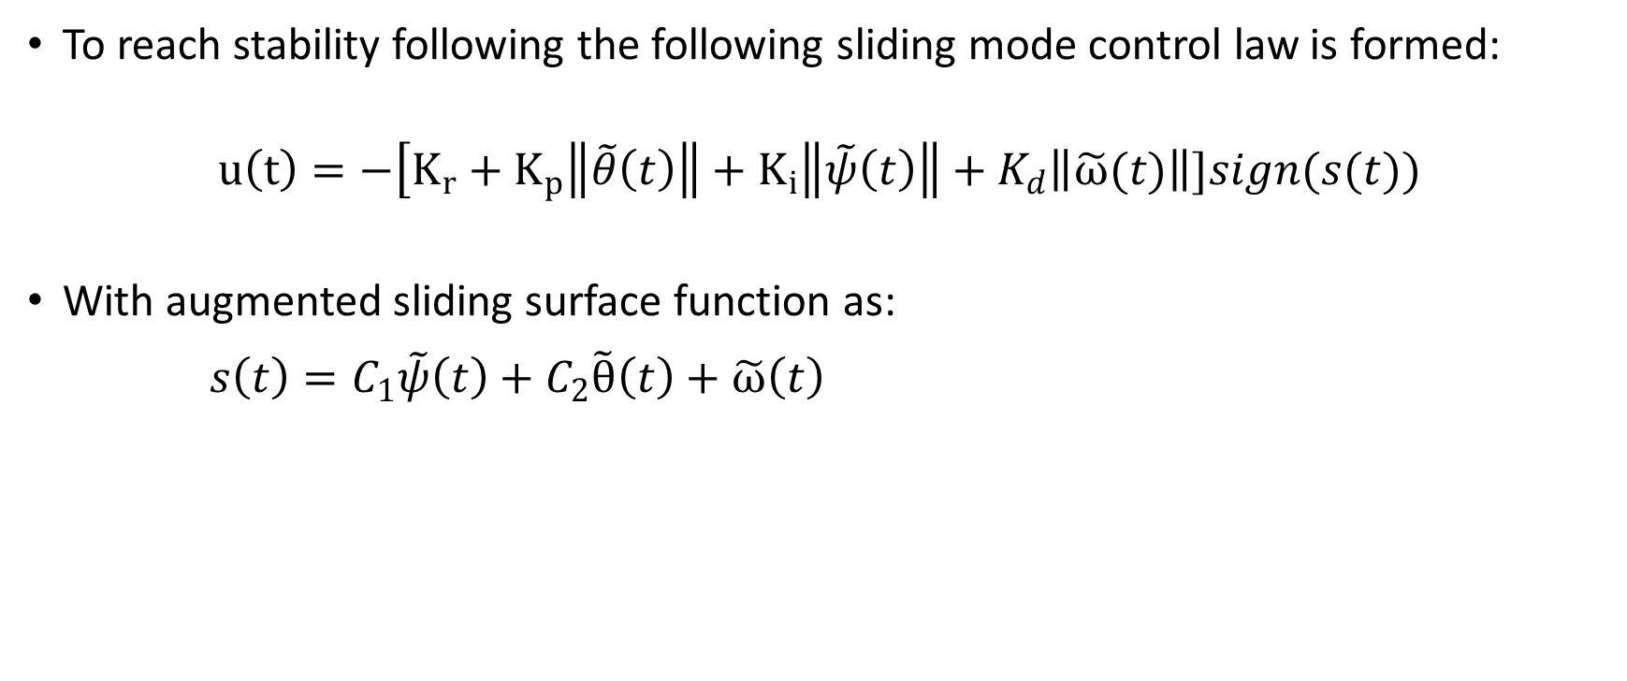
PID SLIDING CONTROLLER WITH PID SLIDING SURFACE.
To reach stability following the following sliding mode control law is formed:
$$u\left(t\right)=−\left[K_{r}+K_{p}\left\|\tilde{θ}\left(t\right)\right\|\right.+K_{i}\left\|\tilde{ψ}\left(t\right)\right\|+K_{d}\left\|\tilde{ω}(t)\right\|]sign(s(t))$$
With augmented sliding surface function as:
$s\left(t\right)=C_{1}\tilde{ψ}\left(t\right)+C_{2}\tilde{θ}\left(t\right)+\tilde{ω}\left(t\right)$

Slide 7
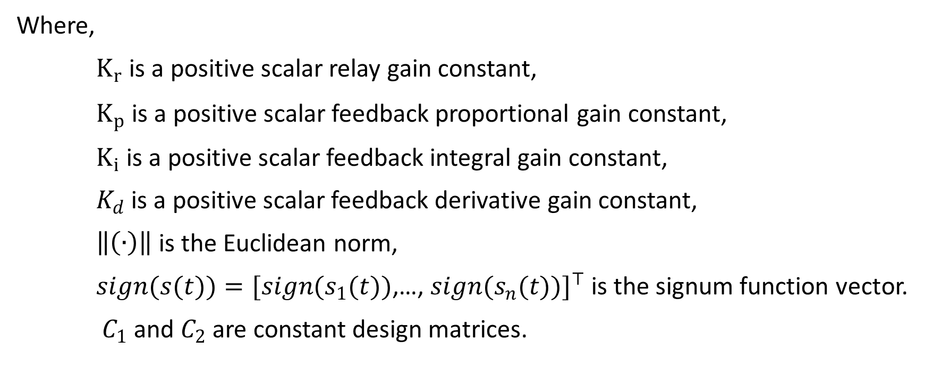
Where,
$K_{r}$ is a positive scalar relay gain constant,
$K_{p}$ is a positive scalar feedback proportional gain constant,
$K_{i}$ is a positive scalar feedback integral gain constant,
$K_{d}$ is a positive scalar feedback derivative gain constant,
$\left\|\left(∙\right)\right\|$is the Euclidean norm,
$sign(s(t))=[sign(s_{1}(t))$,…, $sign(s_{n}(t))]^{⊤}$ is the signum function vector.
$C_{1}$ and $C_{2}$ are constant design matrices.

Slide 8
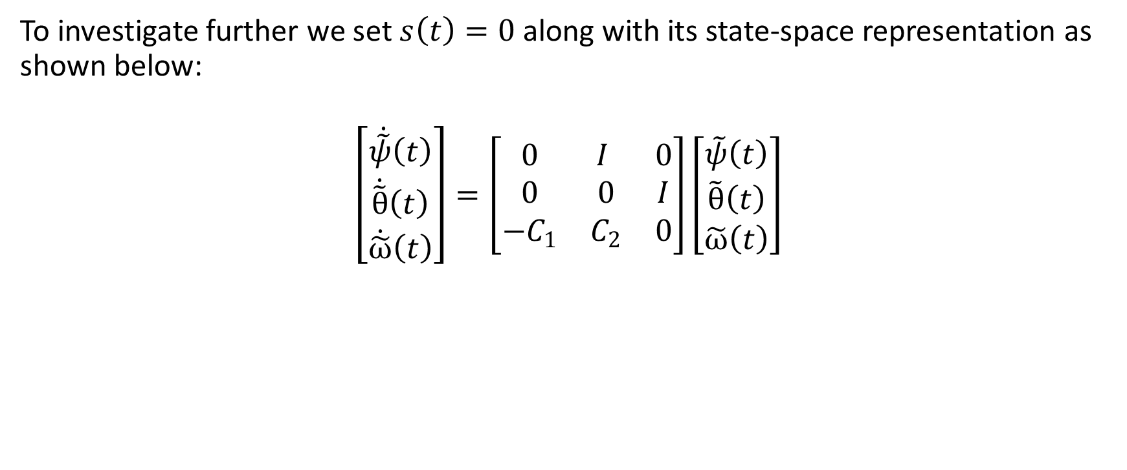
To investigate further we set $s\left(t\right)=0$ along with its state-space representation as shown below:
$$\left[\begin{matrix}\dot{\tilde{ψ}}\left(t\right) \\ \dot{\tilde{θ}}\left(t\right) \\ \dot{\tilde{ω}}\left(t\right)\end{matrix}\right]=\left[\begin{matrix}0 & I & 0 \\ 0 & 0 & I \\ {−C}_{1} & C_{2} & 0\end{matrix}\right]\left[\begin{matrix}\tilde{ψ}\left(t\right) \\ \tilde{θ}\left(t\right) \\ \tilde{ω}\left(t\right)\end{matrix}\right]$$

Slide 9
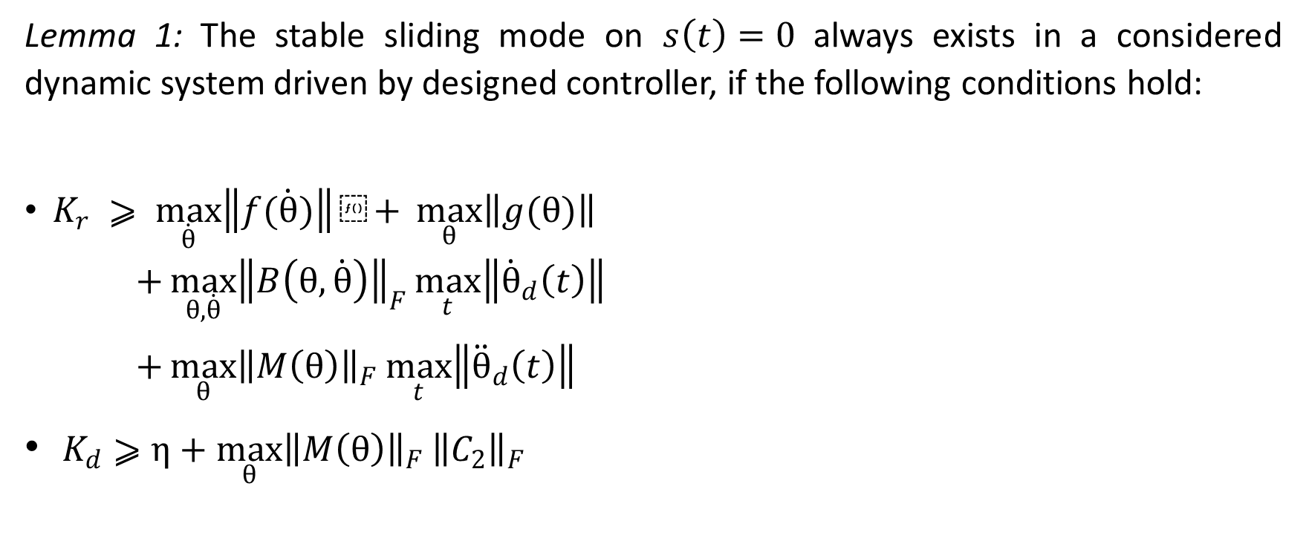
Sliding Conditions
Lemma 1: The stable sliding mode on $s\left(t\right)=0$ always exists in a considered dynamic system driven by designed controller, if the following conditions hold:
$K_{r} ⩾ \max_{\dot{θ}}\left\|f(\dot{θ})\right\|⁡+ \max_{θ}\left\|g(θ)\right\|$ $+\max_{θ,\dot{θ}}{{\left\|B\left(θ,\dot{θ}\right)\right\|}_{F}}\max_{t}\left\|{\dot{θ}}_{d}\left(t\right)\right\|$
$+\max_{θ}{{\left\|M\left(θ\right)\right\|}_{F}}\max_{t}\left\|{\ddot{θ}}_{d}\left(t\right)\right\|$
$K_{d}⩾η+\max_{θ}{{\left\|M\left(θ\right)\right\|}_{F}}{\left\|C_{2}\right\|}_{F}$

Slide 10
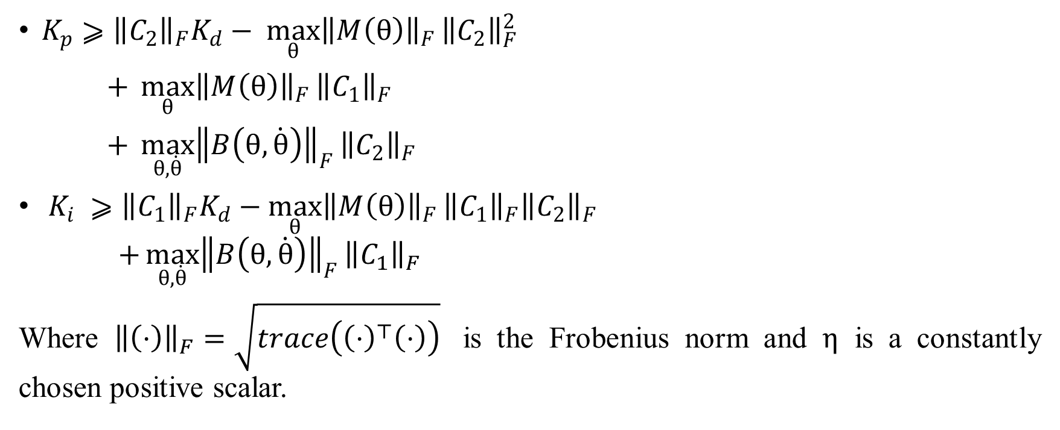
$K_{p}⩾{\left\|C_{2}\right\|}_{F}K_{d}− \max_{θ}{{\left\|M\left(θ\right)\right\|}_{F}}{\left\|C_{2}\right\|}_{F}^{2}$
$+ \max_{θ}{{\left\|M\left(θ\right)\right\|}_{F}}{\left\|C_{1}\right\|}_{F}$
$+ \max_{θ,\dot{θ}}{{\left\|B\left(θ,\dot{θ}\right)\right\|}_{F}}{\left\|C_{2}\right\|}_{F}$
$K_{i} ⩾{\left\|C_{1}\right\|}_{F}K_{d}−\max_{θ}{{\left\|M\left(θ\right)\right\|}_{F}}{\left\|C_{1}\right\|}_{F}{\left\|C_{2}\right\|}_{F}$ $+\max_{θ,\dot{θ}}{{\left\|B\left(θ,\dot{θ}\right)\right\|}_{F}}{\left\|C_{1}\right\|}_{F}$
Where ${\left\|\left(⋅\right)\right\|}_{F}=\sqrt{trace\left({\left(⋅\right)}^{⊤}\left(⋅\right)\right)}$ is the Frobenius norm and $η$ is a constantly chosen positive scalar.

Slide 11
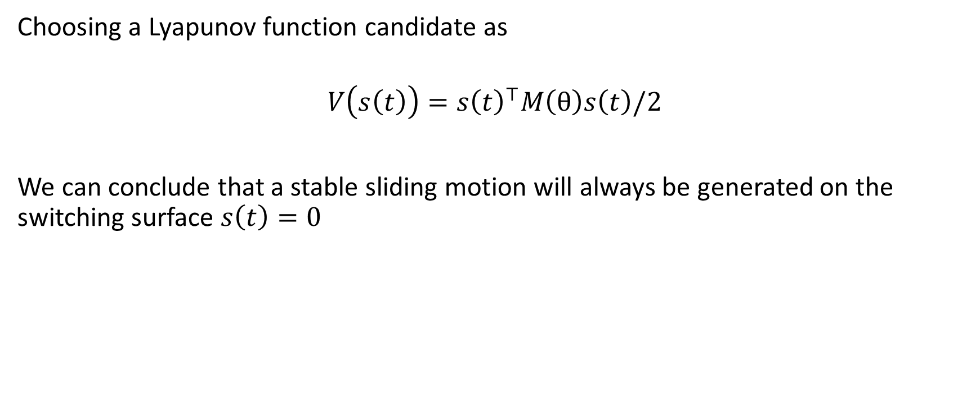
Choosing a Lyapunov function candidate as
$$V\left(s\left(t\right)\right)=s{\left(t\right)}^{⊤}M\left(θ\right)s\left(t\right)/2$$
We can conclude that a stable sliding motion will always be generated on the switching surface $s\left(t\right)=0$

Slide 12
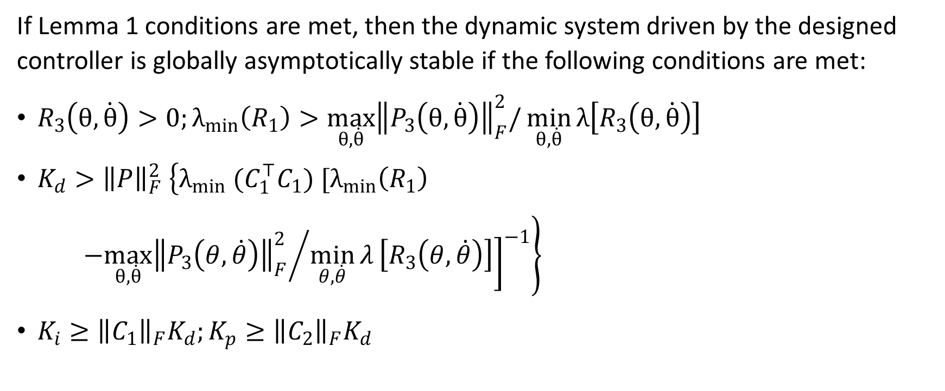
GLOBAL ASYMPTOTIC STABILITY
If Lemma 1 conditions are met, then the dynamic system driven by the designed controller is globally asymptotically stable if the following conditions are met:
$R_{3}\left(θ,\dot{θ}\right)>0;λ_{min}\left(R_{1}\right)>\max_{θ,\dot{θ}}{\left\|P_{3}\left(θ,\dot{θ}\right)\right\|}_{F}^{2}/\min_{θ,\dot{θ}}{λ\left[R_{3}\left(θ,\dot{θ}\right)\right]}$
$K_{d}>{\left\|P\right\|}_{F}^{2} \left\{λ_{min} (C_{1}^{⊤}C_{1}) [λ_{min}\left(R_{1}\right)\right.$
${−\max_{θ,\dot{θ}}{\left\|P_{3}\left(θ,\dot{θ}\right)\right\|}_{F}^{2}}/{\left.{\left.\min_{θ,\dot{θ}}{λ}\left[R_{3}\left(θ,\dot{θ}\right)\right]\right]}^{−1}\right\}}$
$K_{i}≥{\left\|C_{1}\right\|}_{F}K_{d};K_{p}≥{\left\|C_{2}\right\|}_{F}K_{d}$

Slide 13
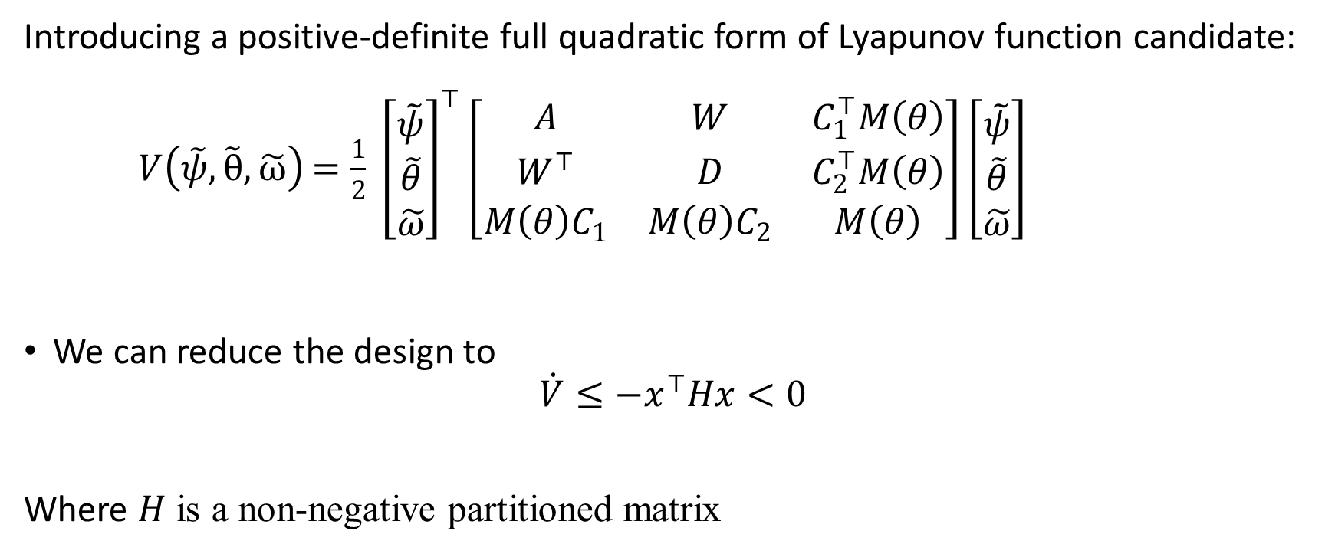
Introducing a positive-definite full quadratic form of Lyapunov function candidate:
$V\left(\tilde{ψ},\tilde{θ},\tilde{ω}\right)$ $=\frac{1}{2} {\left[\begin{matrix}\tilde{ψ} \\ \tilde{θ} \\ \tilde{ω}\end{matrix}\right]}^{⊤}\left[\begin{matrix}A & W & C_{1}^{⊤}M\left(θ\right) \\ W^{⊤} & D & C_{2}^{⊤}M\left(θ\right) \\ M\left(θ\right)C_{1} & M\left(θ\right)C_{2} & M\left(θ\right)\end{matrix}\right]\left[\begin{matrix}\tilde{ψ} \\ \tilde{θ} \\ \tilde{ω}\end{matrix}\right]$
We can reduce the design to
$$\dot{V}≤−x^{⊤}Hx<0$$
Where $H$ is a non-negative partitioned matrix

Slide 14
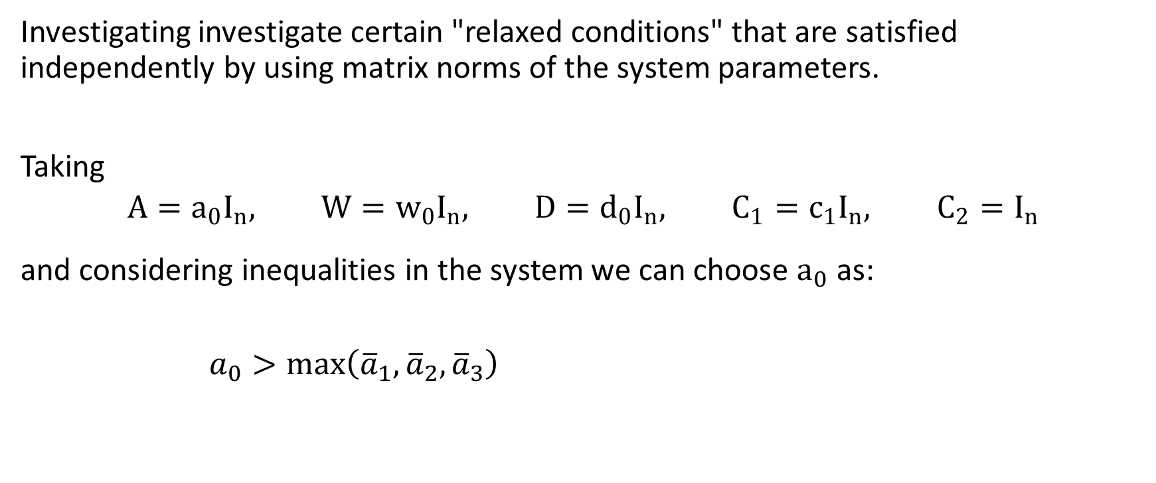
REDUCED DESIGN
Investigating investigate certain "relaxed conditions" that are satisfied independently by using matrix norms of the system parameters.
Taking
$$A=a_{0}I_{n}, W=w_{0}I_{n}, D=d_{0}I_{n}, C_{1}=c_{1}I_{n}, C_{2}=I_{n}$$
and considering inequalities in the system we can choose $a_{0}$ as:
$a_{0}>\max\left({\overline{a}}_{1},{\overline{a}}_{2},{\overline{a}}_{3}\right)$

Slide 15

Where:
${\overline{a}}_{1}={\overline{c}}_{1}\left[c_{1}^{2}+{\left(c_{2}−c_{1}\right)}^{2}\right]$,
${\overline{a}}_{2}=\left[{\overline{c}}_{2}c_{1}+{\overline{c}}_{3}c_{2}+\sqrt{{\left({\overline{c}}_{2}c_{1}+{\overline{c}}_{3}c_{2}\right)}^{2}+6{\overline{c}}_{4}c_{1}^{2}}\right]/3$,
${\overline{a}}_{3}=\left[{\overline{c}}_{2}c_{1}+{\overline{c}}_{3}c_{2}+\sqrt{{\left({\overline{c}}_{2}c_{1}+{\overline{c}}_{3}c_{2}\right)}^{2}+6\left({\overline{c}}_{4}c_{1}^{2}+{\overline{c}}_{5}^{2}\left.\left.{\left(c_{2}c_{1}^{−1}−0.5\right)}^{−1}\right)\right]\right.}\right./3$

Slide 16
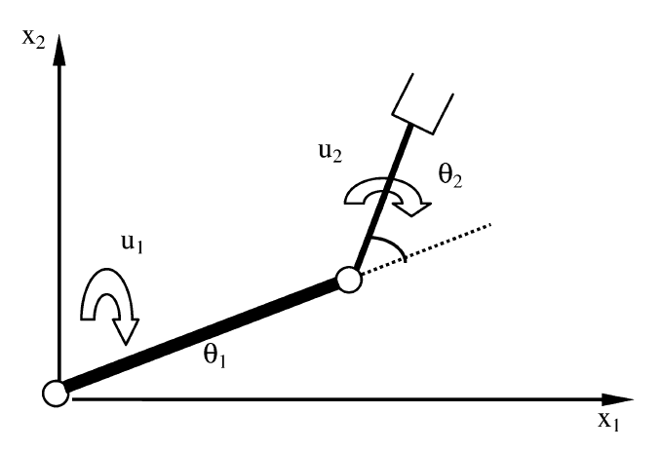

SIMULATION
Let us check the utility of the proposed controller by considering a two-link SCARA type manipulator.
The Variable of the system are taken as:
$$θ=[θ_{1} θ_{2}]$$
$$u=[u_{1} u_{2}]$$

Slide 17
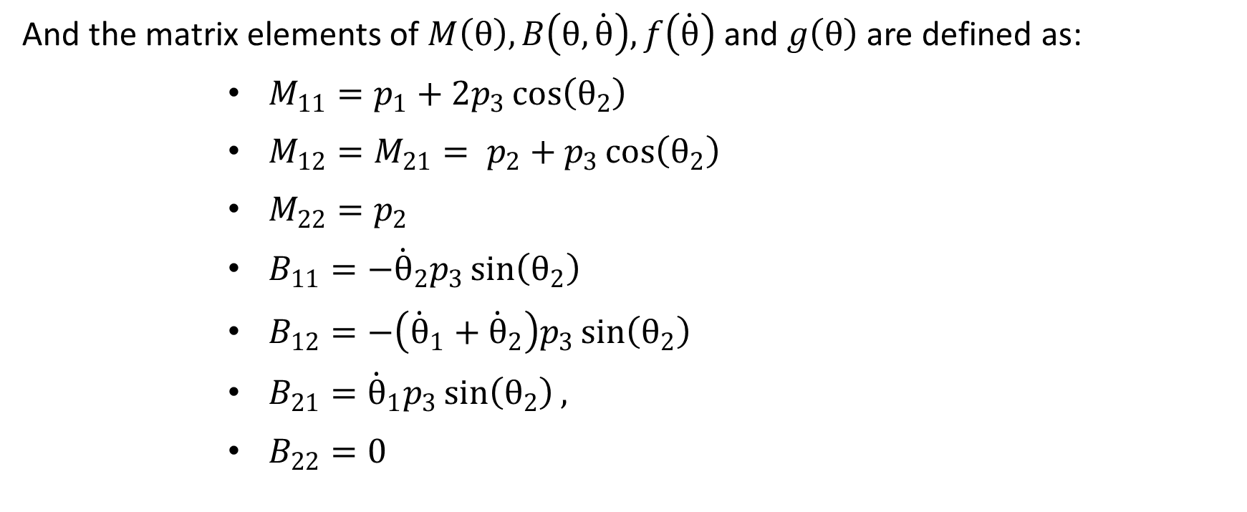
And the matrix elements of $M\left(θ\right), B\left(θ,\dot{θ}\right), f\left(\dot{θ}\right)$ and $g\left(θ\right)$ are defined as:
$M_{11}=p_{1}+2p_{3}\cos\left(θ_{2}\right)$
$M_{12}=M_{21}= p_{2}+p_{3}\cos\left(θ_{2}\right)$
$M_{22}=p_{2}$
$B_{11}=−{\dot{θ}}_{2}p_{3}\sin\left(θ_{2}\right)$
$B_{12}=−\left({\dot{θ}}_{1}+{\dot{θ}}_{2}\right)p_{3}\sin\left(θ_{2}\right)$
$B_{21}={\dot{θ}}_{1}p_{3}\sin\left(θ_{2}\right),$
$B_{22}=0$

Slide 18

$f_{11}=K_{1}{\dot{θ}}_{1}+K_{2}sgn\left({\dot{θ}}_{1}\right)$
$f_{21}=K_{1}{\dot{θ}}_{2}+K_{2}sgn\left({\dot{θ}}_{2}\right)$
$g_{11}=\left(m_{1}+m_{2}\right)l_{1}\cos\left(θ_{1}\right)+m_{2}gl_{2}\cos\left(θ_{1}+θ_{2}\right)$
$g_{21}=m_{2}gl_{2}\cos\left(θ_{1}+θ_{2}\right)$

Slide 19

And the system parameters are taken as:
$p_{1} = 3.16$,
$p_{2} = 0.106$,
$p_{3} = 0.173$,
$l_{1} = 0.36$,
$l_{2} = 0.24$,
$K_{1} = 1$,
$K_{2} = 10$,
$c = 1s^{−1}$

Slide 20
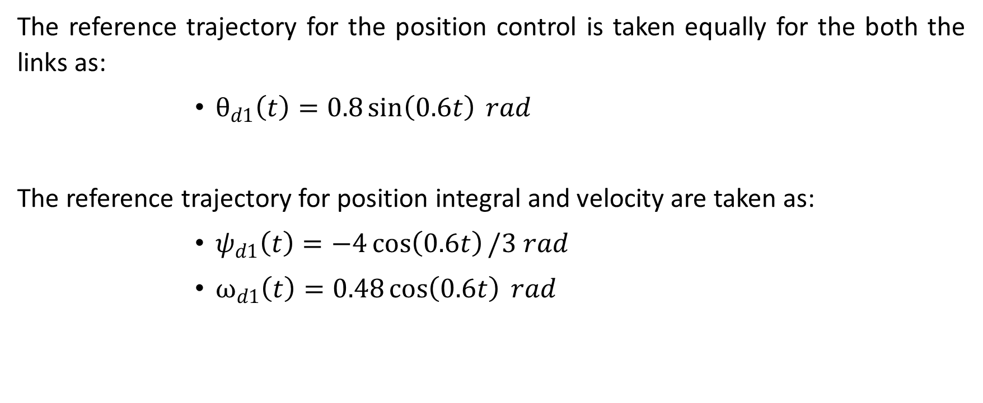
The reference trajectory for the position control is taken equally for the both the links as:
$θ_{d1}\left(t\right)=0.8\sin\left(0.6t\right) rad$
The reference trajectory for position integral and velocity are taken as:
$ψ_{d1}\left(t\right)=−4\cos\left(0.6t\right)/3 rad$
$ω_{d1}\left(t\right)=0.48\cos\left(0.6t\right) rad$

Slide 21

The sampling time is taken as 10.0 for whole simulation and the control parameters are taken as:
$K_{p}=K_{i}=K_{d}=K_{r}=10.I, { C}_{1}=10.I, { C}_{2}=1000.I$

Slide 22
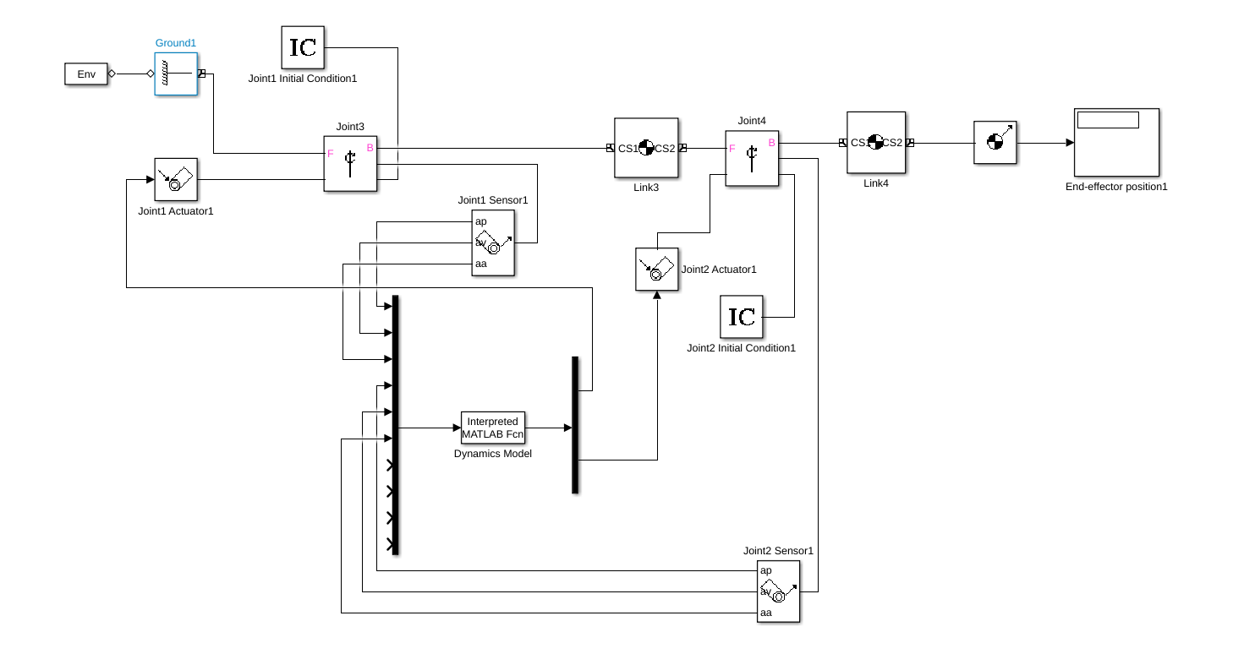
Dynamics and the control of the system are designed in MATLAB Simulink
Dynamic model of the two-link SCARA type manipulator

Slide 23
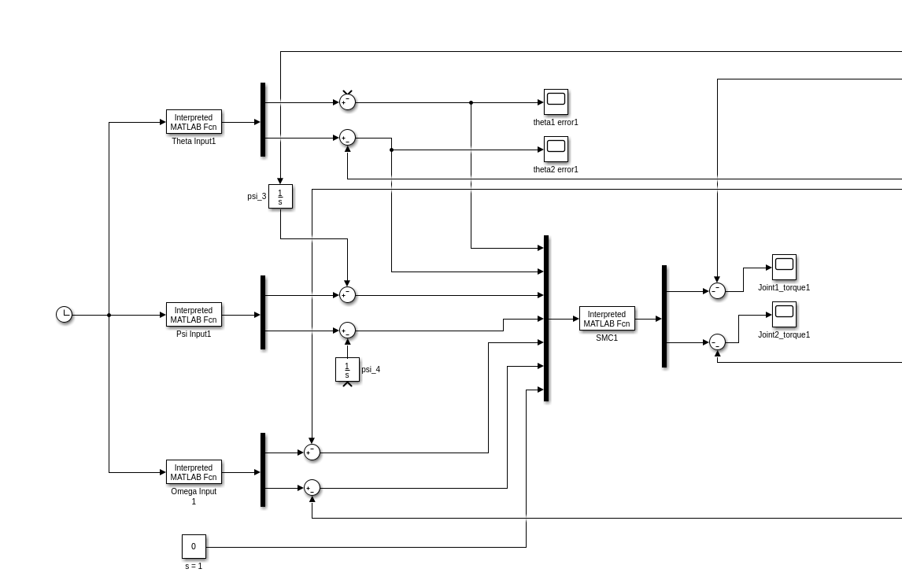
Variable Structure PID Controller model

Slide 24
SIMULATION RESULT & CONCLUSION
The Variable Structure PID Controller model and two-link dynamic system are replicated in MATLAB Simulink to test the result and the robustness of the system.
However, because of lack of data available of some parameters such as input signal error of joint angles, joint angular velocities, we are not able to conclude satisfactory outcome for the tracking stabilization of robot motion using new Variable Structure PID controller we have redesigned based on original authors’ conclusion.

Slide 25
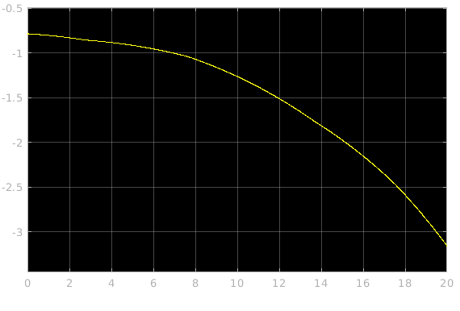
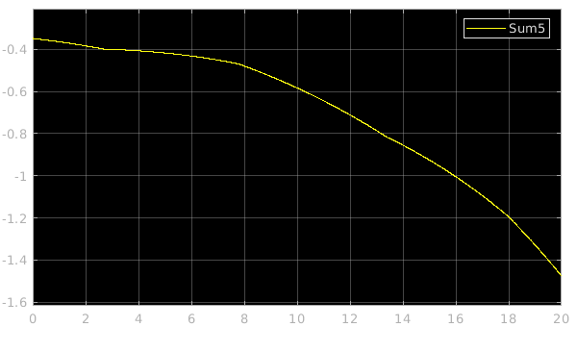


Fig 1. Error in $θ_{1}$ w.r.t time
Fig 2. Error in $θ_{2}$ w.r.t time

Slide 26
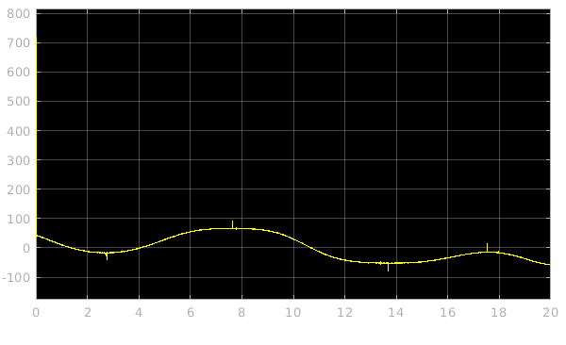
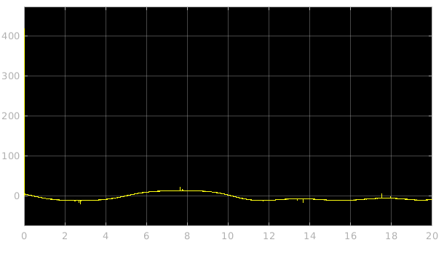
Fig 3. Torque provided to the first link over time
Fig 4. Torque provided to the second link over time

Slide 27
REFERENCES
[1] V. I. Utkin, Sliding Modes in Control and Optimization. New York: Springer-Verlag, 1991.
[2] J.-J. E. Slotine and W. Li, Applied Nonlinear Control. Englewood Cliffs, NJ: Prentice-Hall, 1991.
[3] J. Y. Hung, W. Gao, and J. C. Hung, “Variable structure control: A survey,” IEEE Trans. Ind. Electron., vol. 40, no. 1, pp. 2–21, Feb. 1993.
[4] A. Ferrara, L. Magnani, and R. Scattolini, “A globally stabilizing hybrid variable structure control strategy,” IEEE Trans. Automat. Contr., vol. 47, no. 8, pp. 1334–1337, Aug. 2002.
[5] K. D. Young, “Controller design for a manipulator using the theory of variable structure systems,” IEEE Trans. Syst., Man, Cybern., vol. SMC–8, no. 2, pp. 101–109, Feb. 1978.
[6] K. S. Yeung and Y. P. Chen, “A new controller design for manipulators using the theory of variable structure systems,” IEEE Trans. Automat. Cont., vol. 33, no. 2, pp. 200–206, Feb. 1988.
[7] E. Bailey and A. Arapostathis, “A simple sliding mode scheme applied to robot manipulators,” Int. J. Control, vol. 45, no. 4, pp. 1197–1209, 1987.

Slide 28
[8] M. Zhihong and M. Palaniswami, “Robust tracking control for rigid robotic manipulators,” IEEE Trans. Automat. Contr., vol. 39, no. 1, pp. 154–159, Jan. 1994.
[9] K. Erbatur, M. O. Kaynak, and A. Sabanovic, “A study on robustness property of sliding-mode controllers: A novel design and experimental investigations,” IEEE Trans. Ind. Electron., vol. 46, no. 5, pp. 1012–1017, Oct. 1999.
[10] K.-Y. Lian and C.-R. Lin, “Sliding-mode motion/force control of constrained robots,” IEEE Trans. Automat. Contr., vol. 43, no. 8, pp. 1101–1103, Aug. 1998.
[11] E. M. Jafarov and R. Tasaltin, “Design of robust autopilot output integral sliding mode controllers for guided missile systems with parameter perturbations,” Int. J. Aircraft Eng. Aerospace Technol., vol. 33, no. 1, pp. 16–25, 2001.
[12] D. S. Yoo, H. H. Choi, and M. J. Chung, “Adaptive variable structure control for robot manipulators,” in Proc. IEEE-TENCON’92, Melbourne, Australia, Nov., pp. 1028–1032.

Slide 29
[13] E. Jafarov, Y. Istefanopulos, and M. N. A. Parlakçı, “A new variable structure-PID controller for robot manipulators with parameter perturbations: An augmented sliding surface approach,” in Proc. 15th IFAC World Congr., Barcelona, Spain, Jul. 2002.
[14] T. L. Chern and Y. C. Wu, “Integral variable structure control approach for robot manipulators,” Proc. Inst. Electr. Eng., vol. 139, no. 2, pp. 161–166, 1992.
[15] “Design of integral variable structure controller and application to electrohydraulic velocity servosystems,” Proc. Inst. Electr. Eng., vol. 138, no. 5, pp. 439–444, 1991.
[16] C. Abdallah, D. Dawson, P. Dorato, and M. Jamshidi, “Survey of robust control for rigid robots,” IEEE Control Syst. Mag., vol. 11, no. 2, pp. 24–30, Feb. 1991.
[17] H. G. Sage, M. F. De Mathelin, and E. Ostertag, “Robust control of robot manipulators: A survey,” Int. J. Control, vol. 72, no. 16, pp. 1498–1522, 1999.

Slide 30
[18] Y. Stepanenko, Y. Cao, and C. Su, “Variable structure control of robotic manipulator with PID sliding surfaces,” Int. J. Robust Nonlinear Control, vol. 8, pp. 79–90, 1998.
[19] V. Parra-Vega and G. Hirzinger, “Chattering-free sliding mode control for a class of nonlinear mechanical systems,” Int. J. Robust Nonlinear Control, vol. 11, pp. 1161–1178, 2001.
[20] H. Asada and J.-J. E. Slotine, Robot Analysis and Control. New York: Wiley, 1986.
[21] M. Spong and M. Vidyasagar, Robot Dynamics and Control. New York: Wiley, 1989.
[22] NSK Robot Manual, IMI (Integrated Motions Corporated) Direct Drive Manipulator Research and Development Package, 1992.

